Slide 1

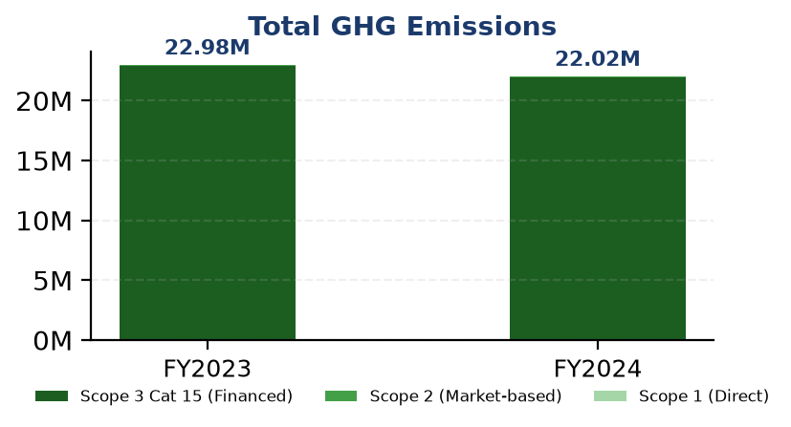
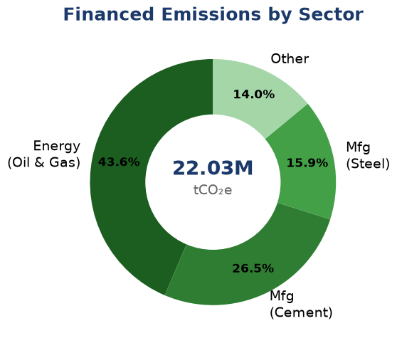
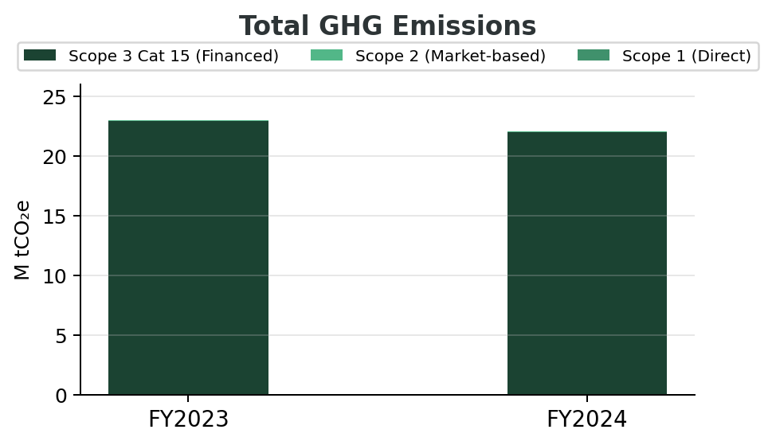
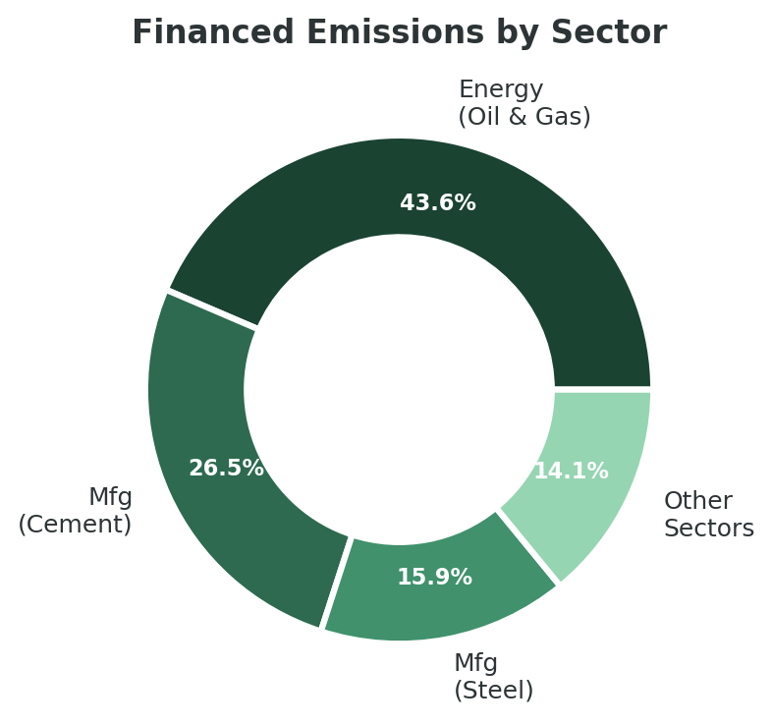
ESG Dashboard
Tokaicom Mitra Indonesia | FY2024
Total GHG
Intensity
PCAF Score
Coverage
22.03M
239.4
3.36
99.78%
tCO₂e ▼ 4.07%
tCO₂e/IDR Bn ▼ 11.3%
/5.0
of total footprint
§"Total (Scope 1+2+3)" → col "Emissions" & "YoY Change"
§1.4 GHG Emissions Intensity → Table 1.4.1 → row "Revenue-Based" → col "Ratio"
§1.3 Financed Emissions → Table 1.3.1 → row "Portfolio Weighted" → col "PCAF Score"
§ Scope 1 Emissions by Source (2024) → col "% of Total"
§1.1 Direct GHG—Scope 1 → Tbl 1.1.2 + §1.2 Scope 2 + §1.3 Scope 3 Cat 15 → Tbl 1.3.1
§1.3 Financed Emissions—Scope 3 Cat 15 → Table 1.3.1 → col "Emission Share (%)"
ESG Scorecard
Board Actions
E
Stable
S
Strong
G
Gap
1
Establish sector emission targets (O&G, Cement, Steel)
Emissions -4.07% YoY
Female 42.3%, Training 49.3h
IFRS/ESRS not established
2
Upgrade PCAF data quality 3.36 → ≤3.0
3
Obtain limited assurance (Scope 1, 2, 3)
§1.1 Direct GHG Emissions—Scope 1 → Table 1.1.2 → col "% Change" (+2.36%)
§2.1.4 Diversity & Equal Opportunity → "42.32%" + §2.1.3 Training → "49.3 hrs"
§3.1 Climate Governance & ESG Oversight → Governance Gap Analysis → para 1
§1.5 Emission Reduction Initiatives → Priority Actions → items 1-3 text + timeline

Slide 2
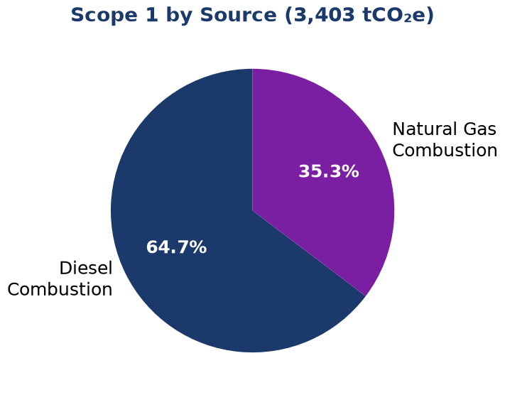
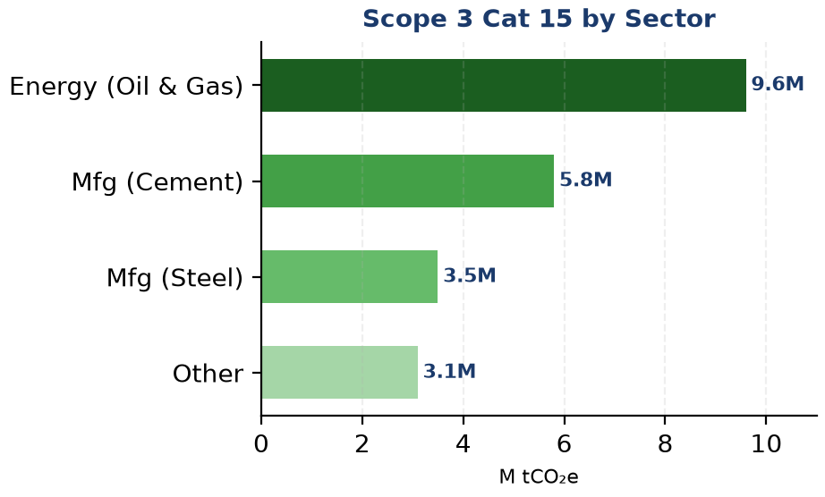
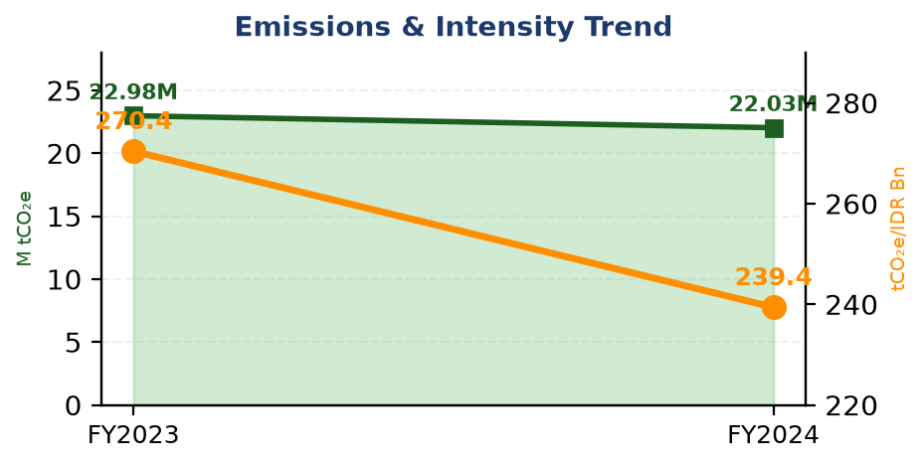
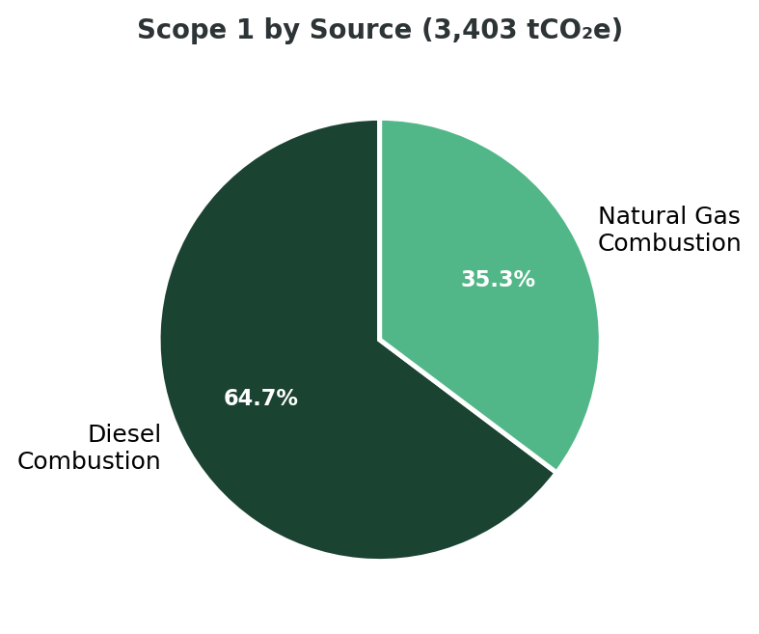
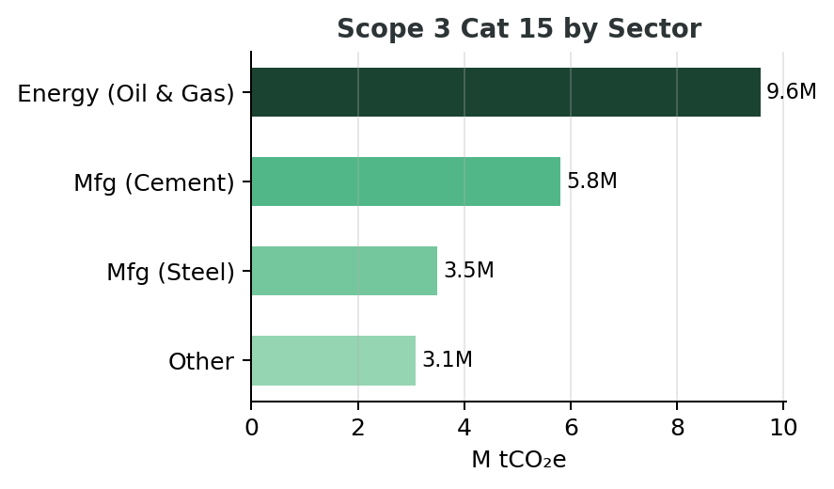
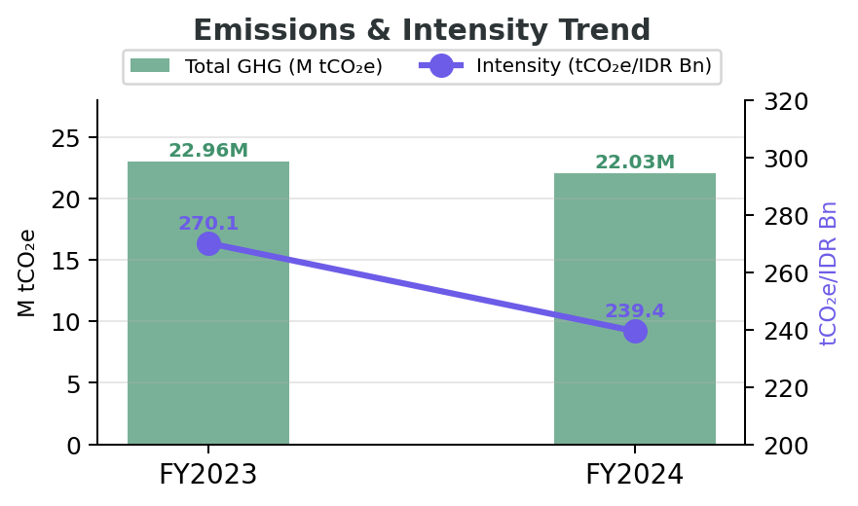
Environmental Deep Dive
Financed Emissions & Operational Footprint
§1.1 Direct GHG Emissions—Scope 1 → Table 1.1.1 → col "Emissions" & "% of Scope 1"
§1.3 Financed Emissions—Scope 3 Cat 15 → Table 1.3.1 → col "Gross Emissions"
⚡
Key Insight
99.78% of total emissions from financed activities (Scope 3 Cat 15). Top 3 sectors = 85.93% of financed emissions despite only 20.70% of portfolio.
§1.3 Financed Emissions—Scope 3 Cat 15 → para 2 "constitute 99.78%" + para 4 "85.93%"
5
3.36/5
-4.07%
Top Facilities
PCAF Score
YoY Change
§1.4 GHG Emissions Intensity → Table 1.4.1 col "Ratio" + Table 1.4.2 col "2024" & "2023"
§1.1 Direct GHG—Scope 1 → Table 1.1.3 → row count
§1.3 Financed Emissions—Scope 3 Cat 15 → para "PCAF score of 3.36"
§1.3 Financed Emissions—Scope 3 Cat 15 → Table 1.3.1 → col "YoY"

Slide 3
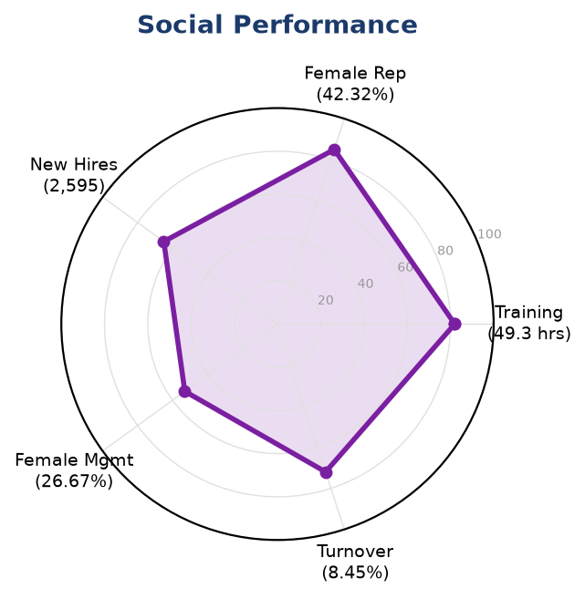
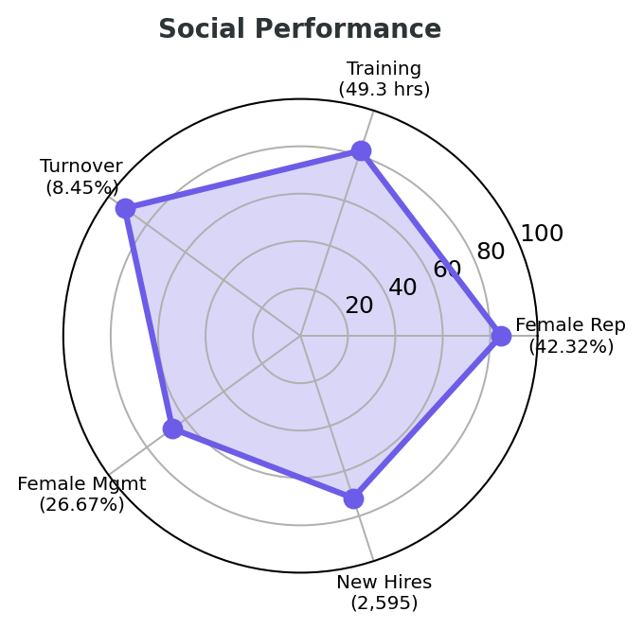
Social & Governance
People Performance & Compliance Gaps
Social Metrics
Governance Gaps
24,997
✖
IFRS S2
Total FTE
Partial (6 gaps)
§2.1.1 Workforce Overview (GRI 2-7) → para 1 → "24,997 FTE"
§3.1 Climate Governance → Framework Requirements Not Met → IFRS S2 Para 5-7
42.32%
✖
ESRS E1
Female %
Partial (6 gaps)
§2.1.4 Diversity & Equal Opportunity (GRI 405-1) → para 1 → "42.32%"
§3.1 Climate Governance → Framework Requirements Not Met → ESRS 2 GOV-3
Social Pillar Score
§2.1.1 Workforce + §2.1.2 Employment + §2.1.3 Training + §2.1.4 Diversity
49.3 hrs
▲
OJK PSPK
Training Hrs
Partial (3 gaps)
§2.1.3 Training & Education (GRI 404-1) → para 1 → "49.3 hrs per FTE"
§3.1 Climate Governance → Framework Requirements Not Met → OJK POJK 51/2017

Slide 4
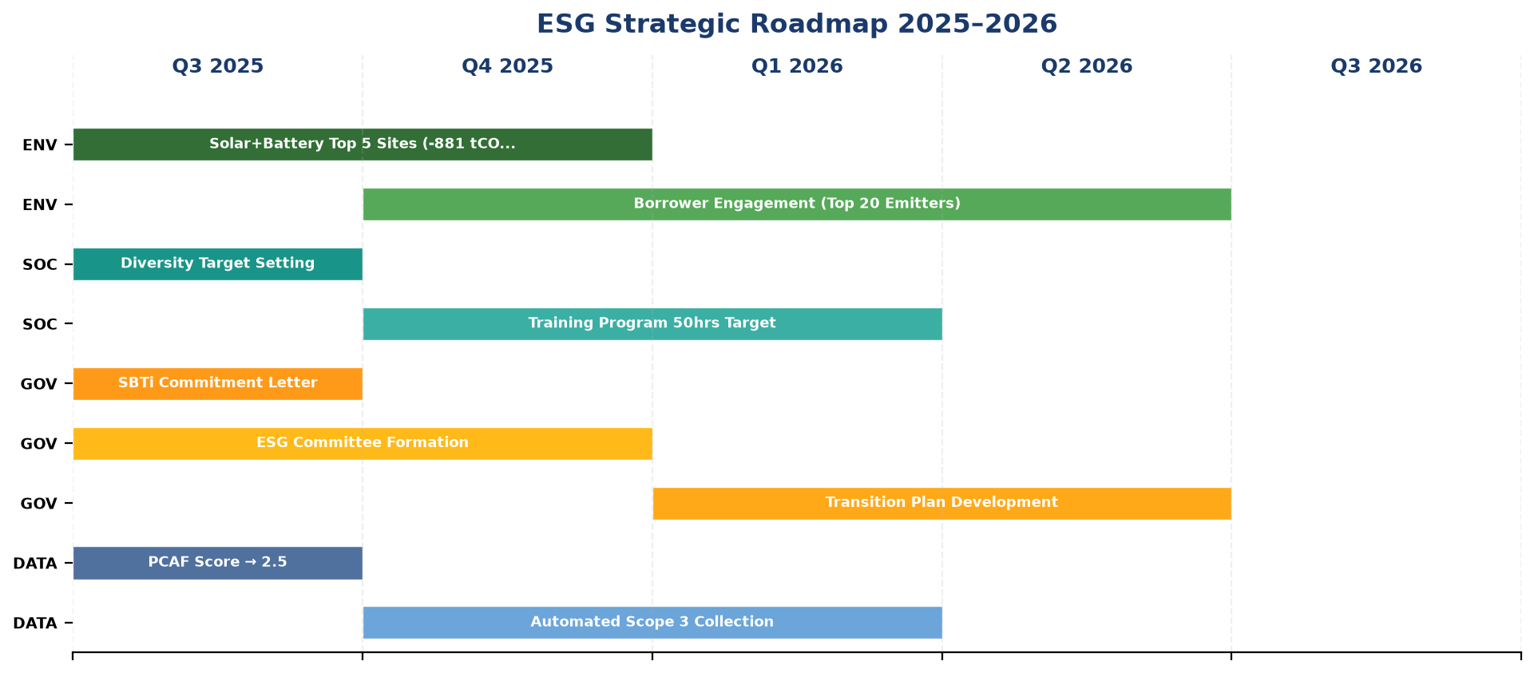
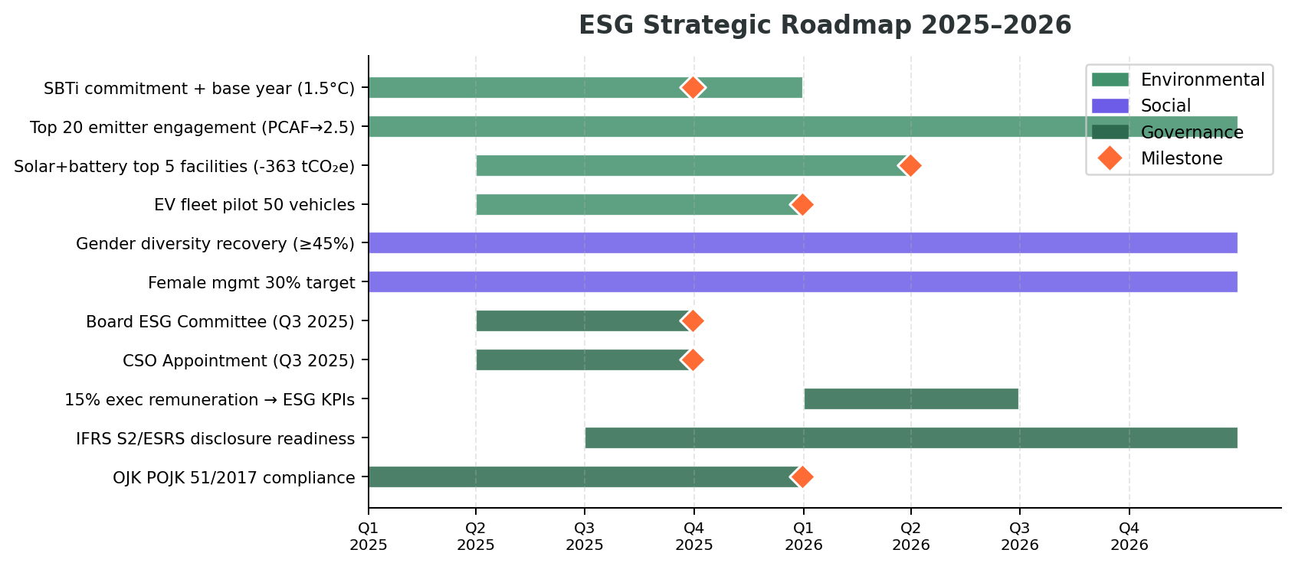
Strategic Roadmap
ESG Initiatives Timeline 2025–2026
§1.1 + §1.4 + §1.5 Emission Reduction → Priority Actions (text + Timeline) + §3.1 Climate Governance → Recommended Infrastructure Phase 1-3

